Slide 1
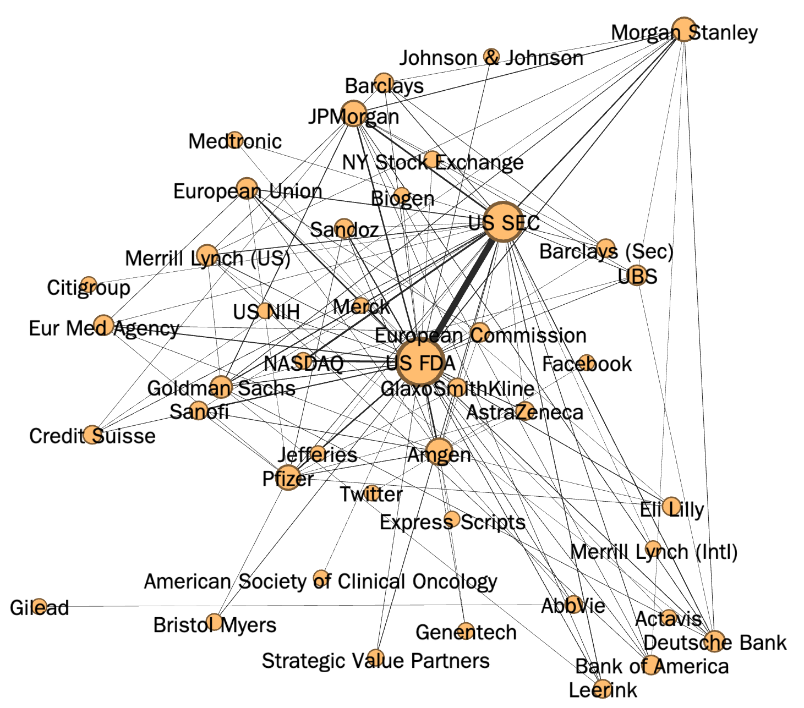
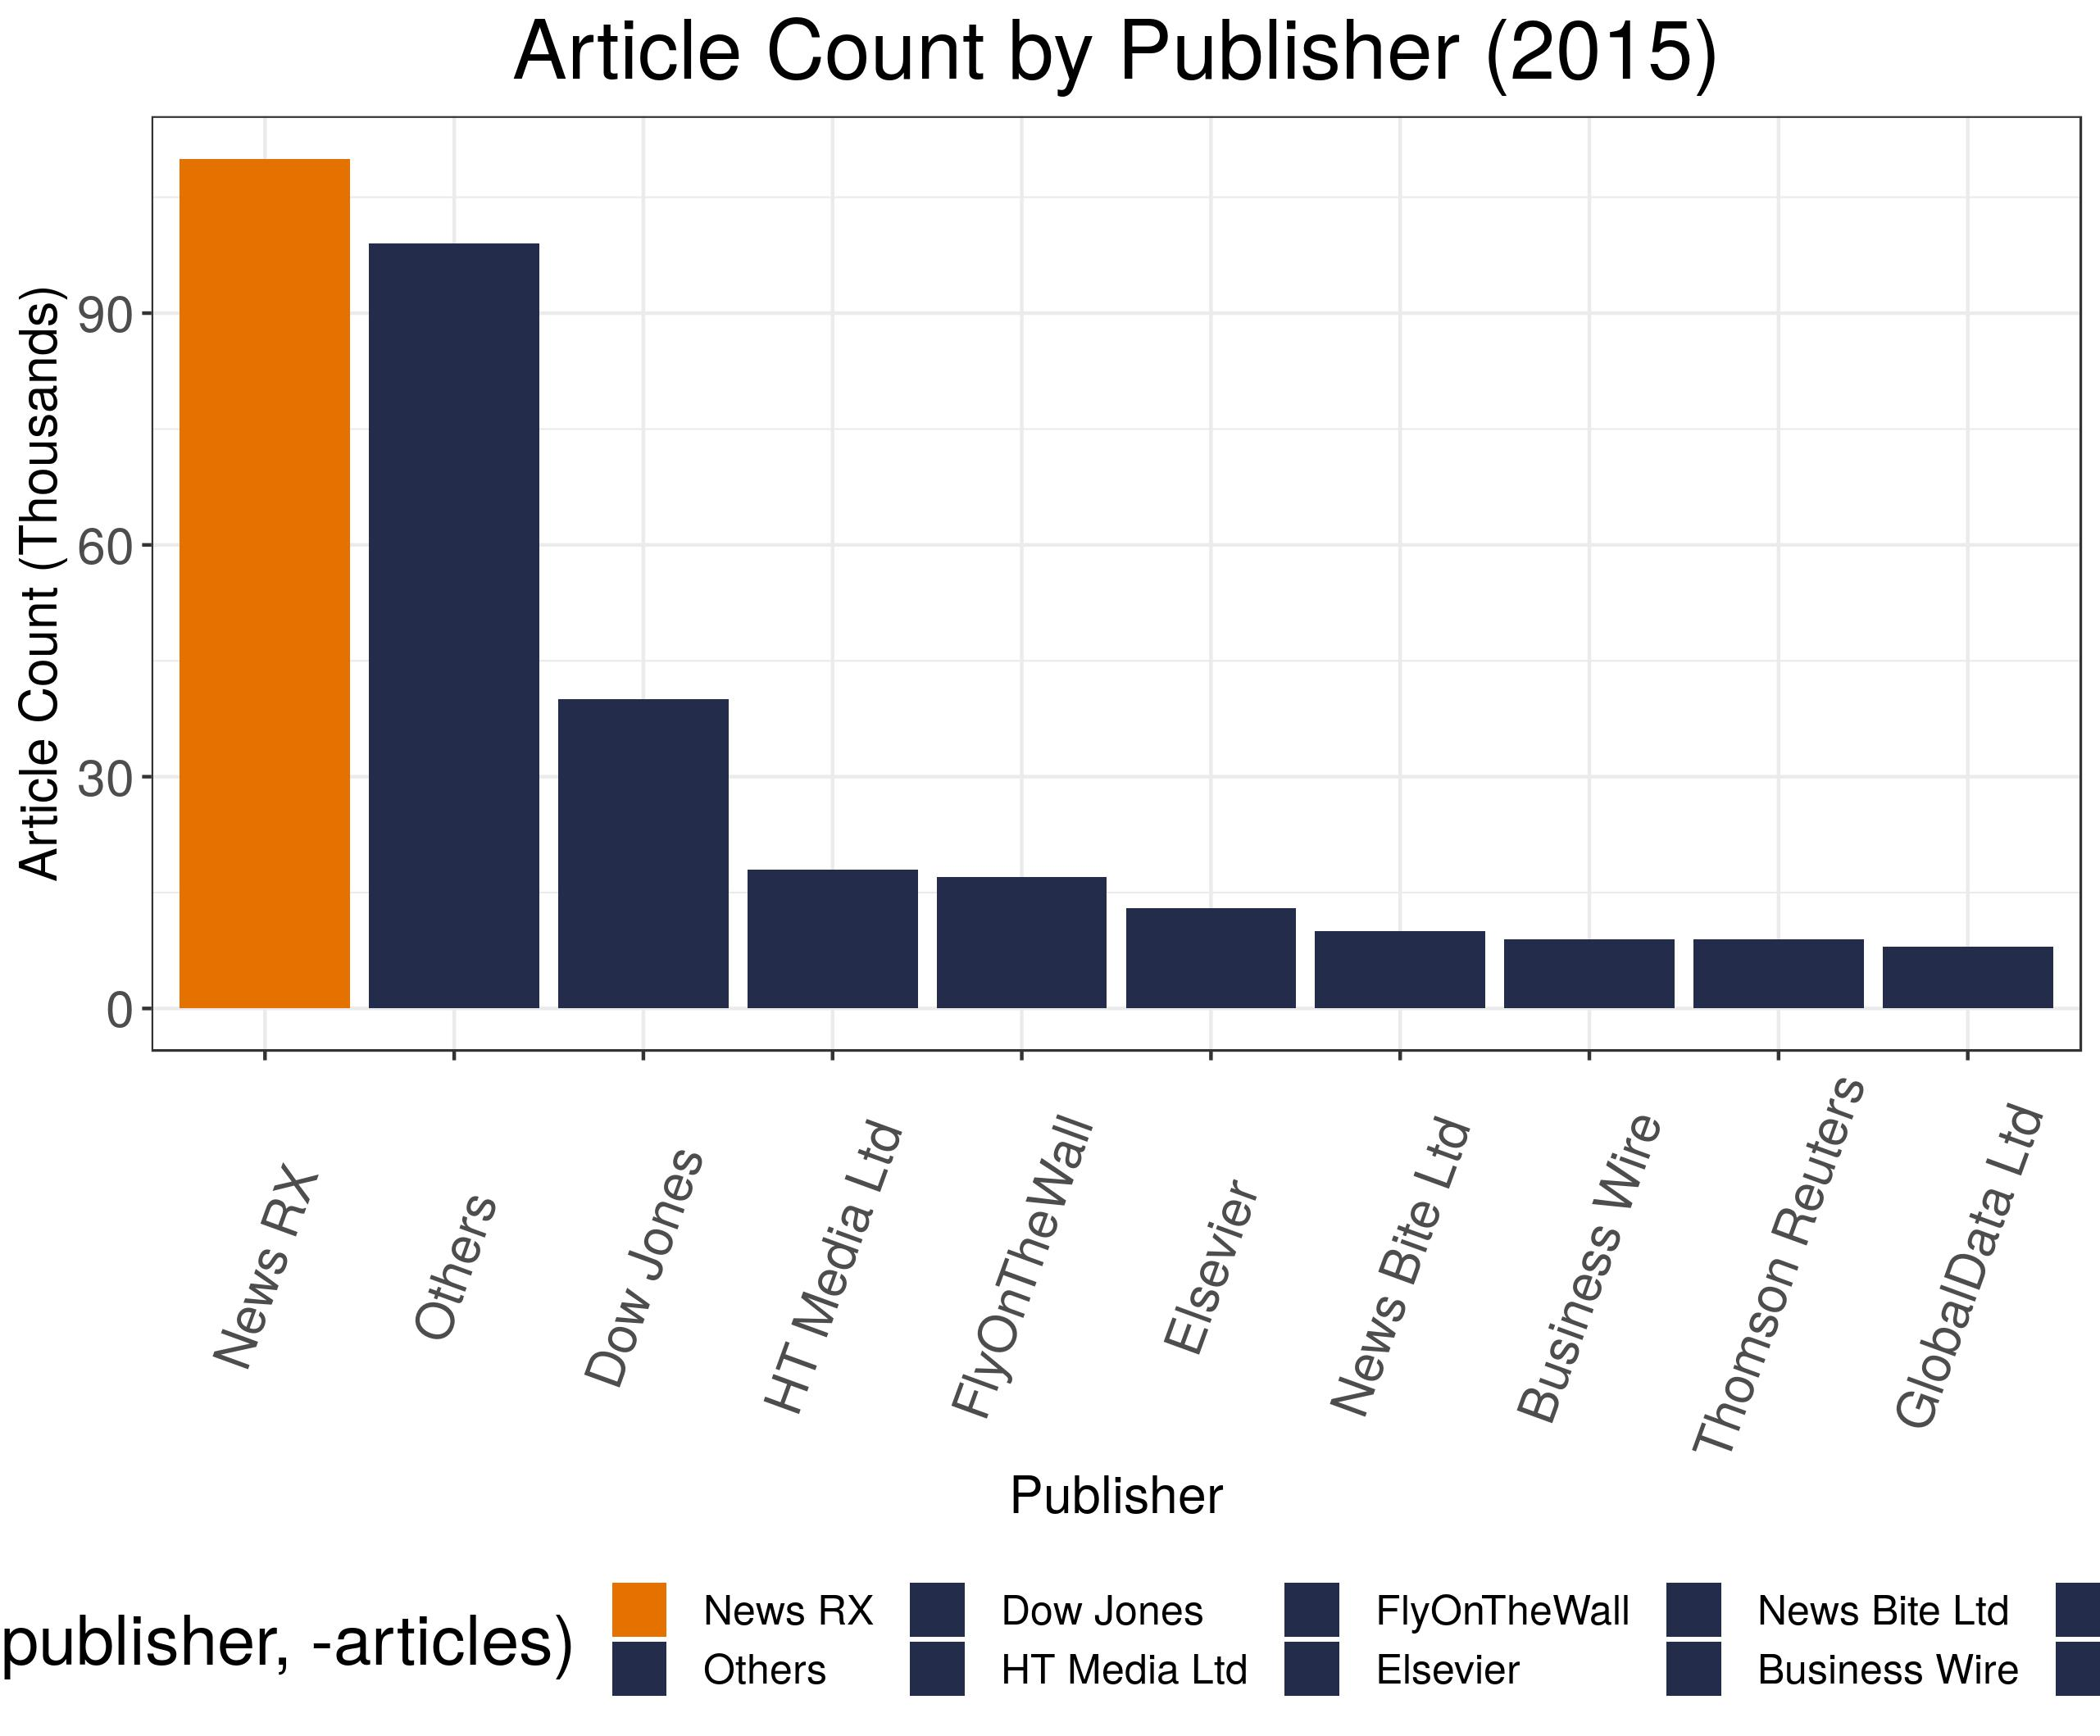
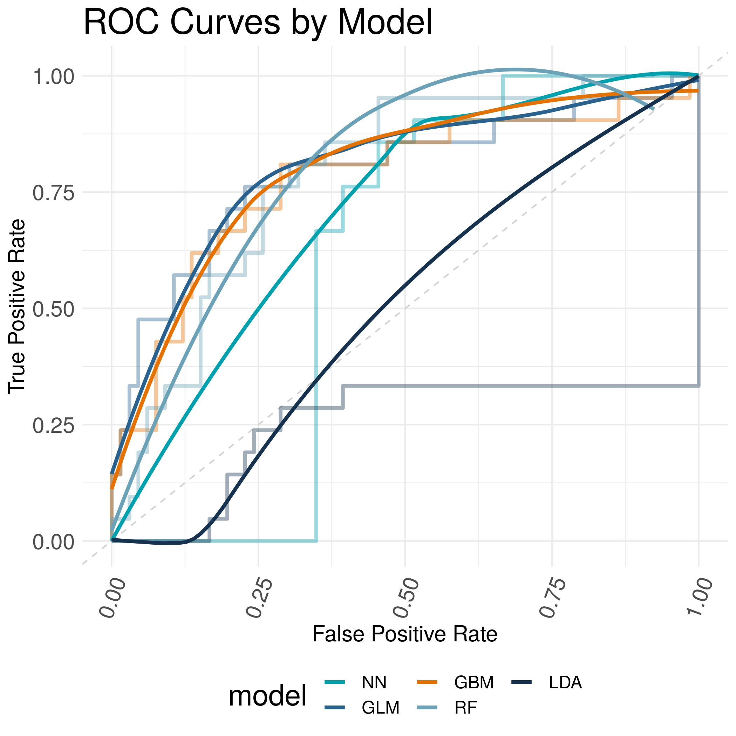
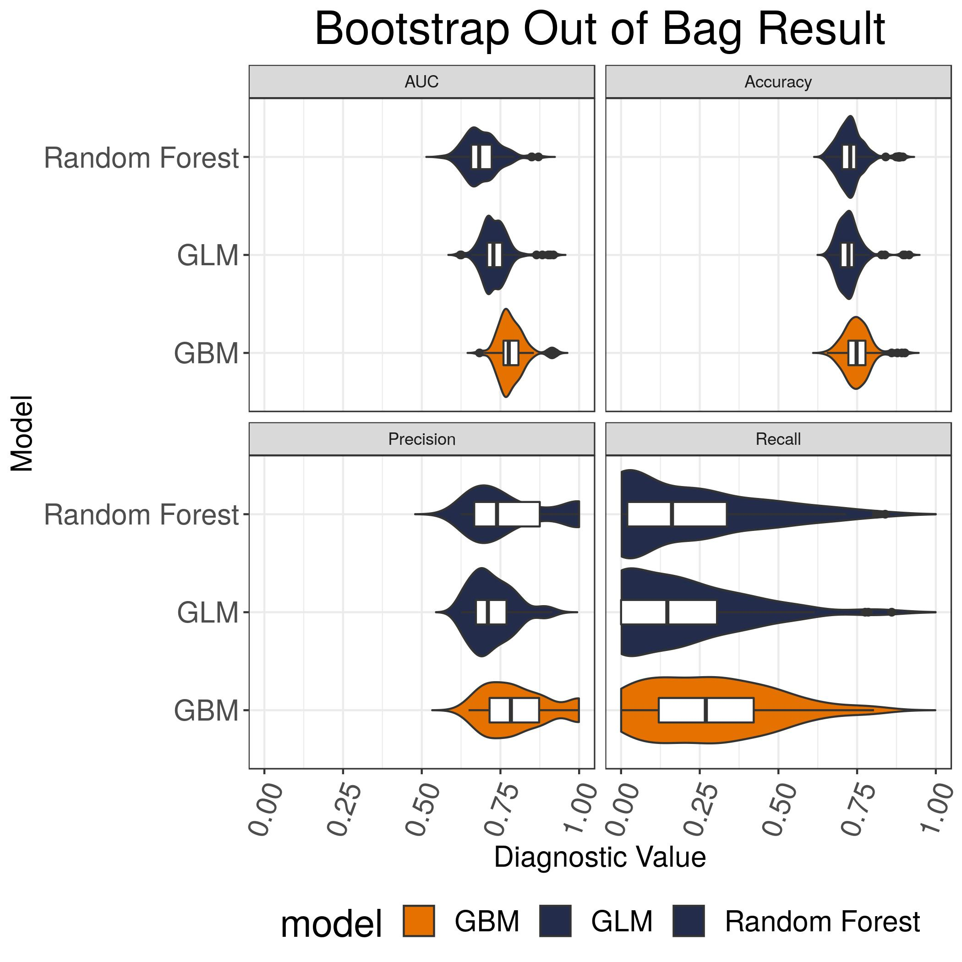

Detecting Pharmaceutical Innovations in News Articles using Machine Learning
DSPG Team: Quinton Neville (Columbia University), Raghav Sawhney (Virginia Tech) SDAD Team: Devika Nair, Gizem Korkmaz, Neil Alexander Kattampallil Sponsor: Gary Anderson, The National Center for Science & Engineering Statistics (NCSES) at the National Science Foundation (NSF)
BACKGROUND
• Innovation is traditionally measured through surveys of selected companies (e.g., Business R&D and Innovation Survey (BRDIS)).
• While BRDIS measures innovation incidence, i.e., the number of innovating firms, NCSES is interested in exploring the possibility of leveraging non-traditional data to richer and complementary innovation measures.
• Our current focus is on Pharmaceutical Drugs and Medical Devices that are heavily regulated by the Food and Drug Administration (FDA).
Research & Development
FDA Application & Approval
Market Launch
Financial Reports
During the three years 2013 to 2015, did your company introduce:
a. New or significantly improved goods (Exclude the simple resale of new
goods purchased from other companies and changes of a solely
aesthetic nature)? … …………………………………………………….... ❑ Yes ❑ No
b. New or significantly improved services? ………………………………… ❑ Yes ❑ No
8
Figure 2. Abstract pipeline representing development of new drugs and medical devices.
Figure 1. BRDIS survey question on innovation following OSLO manual definition of innovation [1].
• We use the OSLO Manual definition of product innovation, which requires that:
Product is new or significantly improved
Product is available on the market
• This project aims to develop machine learning methods to detect mentions of product innovations in news articles.
DATA
• DNA Dataset: We obtain about 2M news articles from Dow Jones about the pharma industry for years 2013-2018.
• The dataset contains over 30 variables on these articles, including publisher, subject, company codes, and publication date.
Figure 4. The network of DNA articles’ company co-mentions in 2015.
We use a subset of DNA articles filtered using innovation keywords to generate the network.
For illustrative purposes
we remove edges occurring
less than 150 times.
The graph shows 43 nodes
and 113 edges.
Node sizes and edge weights represent degree centrality
and number of occurrences
of co-mentions, respectively.
Layout is random.
Figure 3. Top companies mentioned in DNA articles (2015). The top 3 are federal and financial entities, then followed by actual pharmaceutical companies.
METHODS & RESULTS
Our research method is outlined below:
Text processing
Bag of Words (BoW): Creating a document-term matrix with word frequencies
Feature selection to reduce dimension: Least Absolute Shrinkage and Selection Operator (LASSO) applied to P-GLM, RF, GBM
Model training using two labeling methods:
M1: Manual labeling of 433 articles.
137 (31.6%) articles mentioning new or improved drugs or devices
49 (11.3%) of these articles’ products were available on the market
M2: Using DNA-generated subject-code label for “New Products or Services”
A random sample of 1,000 articles (50% with new product label)
Determining cut-off probability thresholds using cost-optimization (using false-negative averse weights)
Performance evaluation with metrics: ROC, accuracy, precision, recall and bootstrapped out-of-bag evaluation
 |  | Performance Metrics
Model | Description | M1: Manual Labeling |  | M2: DNA Labeling
 |  | Accuracy | AUC | Accuracy | AUC
Latent Dirichlet Allocation (LDA) | A bag-of-words model used for topic modeling [2] | 0.76. | 0.78 | 0.54 | 0.52
Neural Networks (NN) | Represents data as computationally-weighted nodes organized into layers where learning occurs to build probabilistic edges. Pre-trained using Google AI’s Bidirectional Encoder Representational Transformers (BERT) [3,4] | 0.76 | 0.84 | 0.85 | 0.95
Penalized Generalized Linear Model (P-GLM) | Penalized logistic regression | 0.77 | 0.78 | 0.66 | 0.78
Random Forest (RF) | Averages results of a bootstrapped ‘forest’ of independent decision trees | 0.78 | 0.70 | 0.81 | 0.85
Gradient Boosting Machines (GBM) | A random forest where trees in succession learn from other trees | 0.82 | 0.79 | 0.76 | 0.85
The models using manual labeling result in high accuracy but low recall values. This is due to the low proportion of innovation articles in the training set resulting in low predicted probabilities (of innovation).
FUTURE WORK
REFERENCES
We have developed various machine learning methods to detect innovation in news articles. We observe the need for additional human-labelled training data. Our immediate next steps include:
further investigating and testing the BERT-pretrained NN
detecting company and product names in innovation articles
comparing the findings (number of innovation per company) to FDA approvals
expanding to other (less regulated, less data-rich) industries
[1] OECD/Eurostat (2018). OSLO Manual 2018: Guidelines for Collecting Reporting and Using Data on Innovation, 4th Edition, The Measurement of Scientific Technological and Innovation Activities, OECD Publishing, Paris/Eurostat, Luxembourg.
[2] Lan, Man et al. “Text Representations for Text Categorization: A Case Study in Biomedical Domain.” 2007 International Joint Conference on Neural Networks (2007): 2557-2562.
[3] Siwei Lai, Liheng Xu, Kang Liu, and Jun Zhao. Recurrent convolutional neural networks for text classification. In Proceedings of the Twenty-Ninth AAAI Conference on Artificial Intelligence (AAAI'15). 2015. AAAI Press 2267-2273.
[4] Devlin, J; Chang, Ming-Wei; Lee, Kenton & Toutanova, Kristina. “BERT: Pre-training of Deep Bidirectional Transformers for Language Understanding.” CoRR. October 2018.

